Slide 1
CSD1400 Software Engineering Project 1
Project Introduction
Instructor
Cheng Ding Xiang
cheng.dingxiang@digipen.edu
Gerald Wong
g.wong@digipen.edu
Office Hours
By Appointment
Project Intro
CProcessing & VS
Forming Teams

Slide 2
Project Introduction
Develop an interactive simulation of your choosing (game)
There needs to be:
Start and End (win/lose conditions)
Meaningful decisions for players to make
Interactive elements
Basics (Menu, credits, how to play, etc)

Slide 3
Project Introduction
Work in teams of 4-5 people
You may only form teams with others within the same class session
Submit team roster by Week 2
No changing of teams after week 8
Smaller teams are possible, only if there are no other options available

Slide 4

Project Introduction
Duration ~4 weeks
About 4 weeks of development, more if everyone finishes the solo projects earlier

Slide 5
Project Introduction
Code meaningfully to pass
Everyone needs to code to pass
Must know what you are doing
Cannot rely on content creation to pass

Slide 6
Content Guidelines
DigiPen games must be able to get an EC, E, or E10+ ESRB rating.
Anything that would require a T (13+) rating requires permission from an Assistant Dean.
M (17+) and AO (18+) ratings are not allowed under any circumstances.
Violence
Only cartoon / fantasy violence is allowed—no gore, body parts, realistic blood, etc.
Social Issues
Any references to real-world politics or alcohol/tobacco/drugs require approval.
Sexual Content
Nudity, sex, strongly suggestive sexual themes or references are not allowed.
Language
Profanity and disparaging / stereotyping of race / gender / culture / disability are not allowed.

Slide 7
Copyright Agreement
DigiPen takes cases of plagiarism very seriously.
ALL content in your game projects have to be created from scratch.
You CANNOT use any material that you did not create, whether it is art, music, scripts, code, etc.
You cannot use your friends, family members, public domain material, or other students not in your class (unless you talk to your instructor first).
You can never use outside artists / musicians at all.
Violations of this rule can lead to expulsion!
Please sign the Copyright Agreement Form to signify your understanding of this rule.
Copies of the Form can be downloaded from Moodle.

Slide 8
Grading
Refer to the course syllabus and the final project rubric on Moodle for more information

Slide 9

Using CProcessing Library with Visual Studio
Tech behind the game

Slide 10
Using CProcessing Library with Visual Studio
CProcessing
Library made at DigiPen
Helps with :
Rendering (Drawing)
Input (Mouse and keyboard)
Game State Machine (menu->level1->level2)
Audio (sfx , bgm playing)
Fonts
Math
Windows

Slide 11
Using CProcessing Library with Visual Studio
CProcessing
Under the hood :
OpenGL (Graphics library)
FMOD (Audio library)
SDL2 (Input, Windows)
You would be using these things on your own in the future

Slide 12
Using CProcessing Library with Visual Studio
CProcessing
The point of the solo projects : everyone learns how to use CProcessing
No excuse for not contributing to the team due to lack of knowledge.

Slide 13
Using CProcessing Library with Visual Studio
CProcessing
Documentation can be found here
Important to learn how to read documentation

Slide 14
Using CProcessing Library with Visual Studio
Visual Studio
An IDE (Integrated Development Environment)
Provides help with
Building and compiling (creating an executable)
Debugging (tracing code for errors)
Profiling (speed, memory usage)
Organisation of files and folders

Slide 15
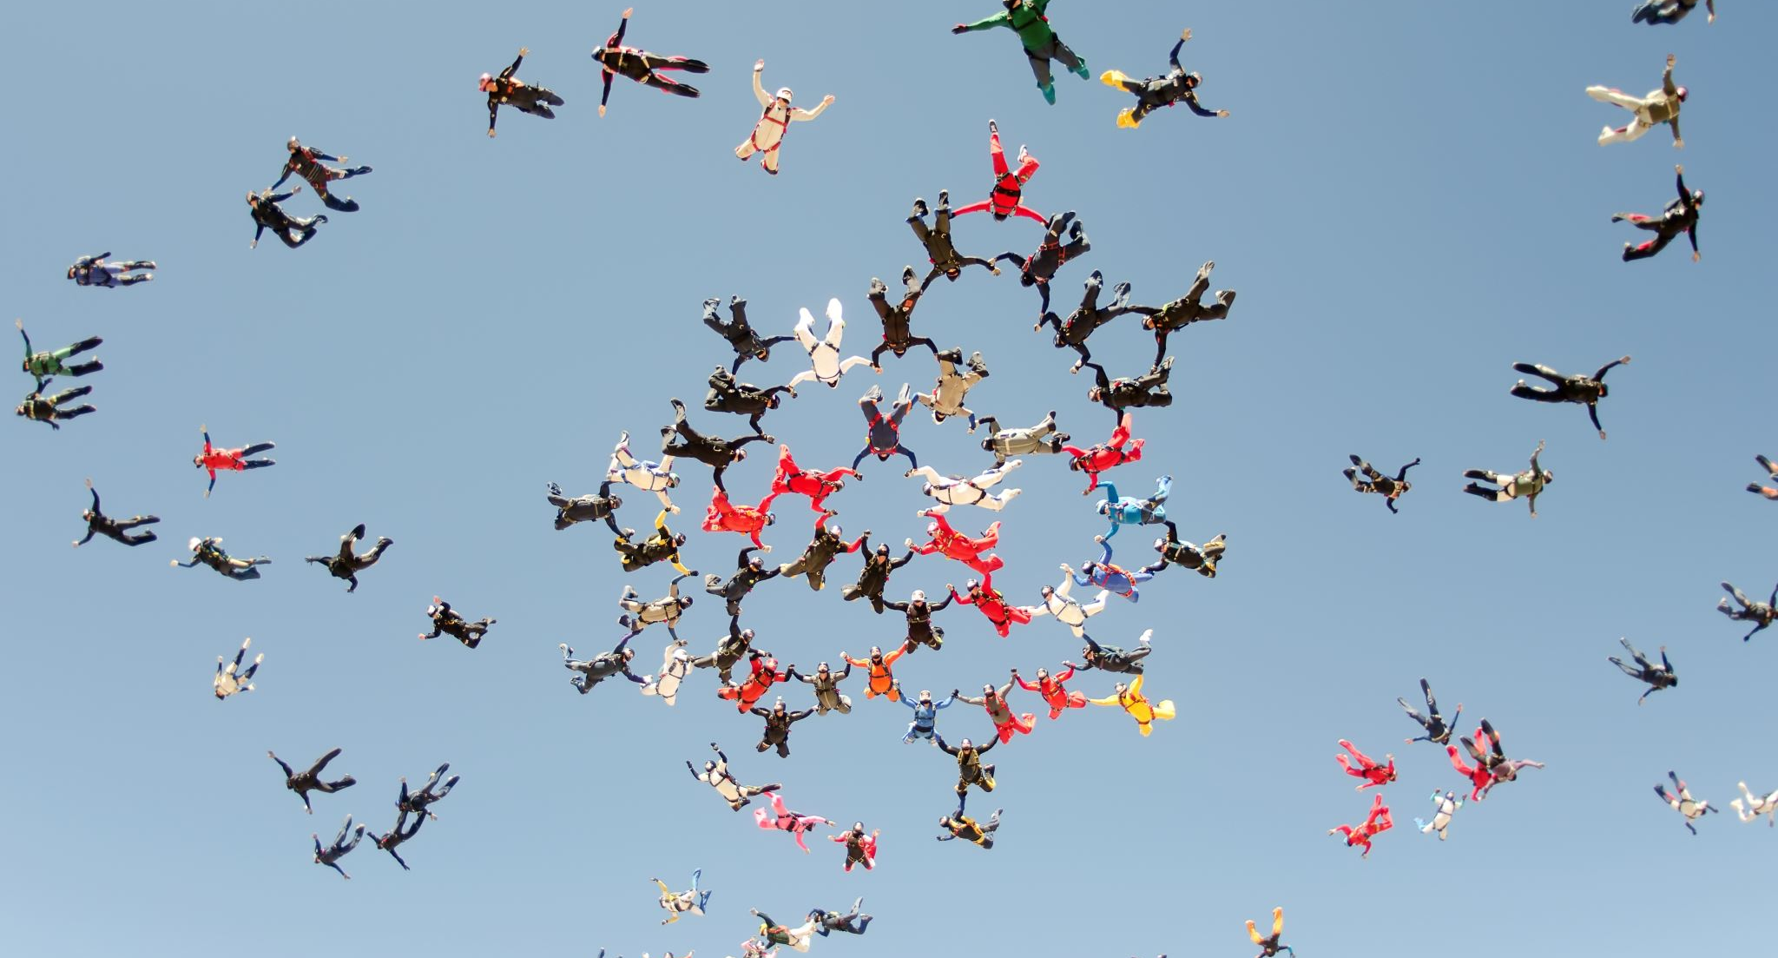
Forming Teams

Slide 16
Reminder
Work in teams of 4-5 people
You may only form teams with others within the same class session
Submit team roster by Week 2
No changing of teams after week 8
Smaller teams are possible, but only in special circumstances

Slide 17
Team Dynamics
Every student is here with different:
Motivations
Prior experience
Life Problems
Skills
Regardless, there are expectations everyone and every team must meet.

Slide 18
Team Dynamics
Based on your individual situation, you will need to decide on :
What effort you can/want to put in
What is your goal at the end of the module
This will guide you when choosing a team

Slide 19
Team Budget
No money involved in this class
The team’s budget is your time, effort and skill
All of which is finite
You are also not allowed to use software or assets that you will have/had paid for.

Slide 20
Team Genres
To help facilitate the finding of teams, explore these Team genres and find others who are in the same genre as you.
This is a rough guide to find a team on the same page as you, which would ease team conflicts.
If you have your own means of finding your own team, by all means do so

Slide 21

Team Genres
PLUS ULTRA
Aim to achieve the best possible grade
Members most likely have some programming experience
Want to push boundaries
Most likely to work through weekends and late hours
Only ask for help for difficult topics beyond class expectations

Slide 22

Team Genres
Live to fight another day (LTFAD)
Aim to pass
Members most likely have little to no experience
Want to be practical and efficient
Worried about surviving other classes

Slide 23
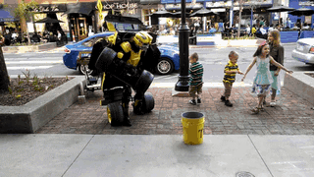
Team Genres
Transform & Transcend (TNT)
Aim to do more than pass
Members most likely have little to no experience
Want to see themselves constantly improve
Take challenges in their stride
Will put in more effort than required

Slide 24
Team Genres
All genres of Teams are capable of getting any grade : A+ to F
A lot depends on execution and attention to detail
The point is to acknowledge everyone on the team, and make things work.

Slide 25
Finding Teams
Teams can only be formed within the same Lab Sessions
Section A
Section B
Some options for finding teams:
Post on “Looking For Group” forum on Moodle
Post on “Looking For Group” channel on MSTeams

Slide 26
Team Rosters
Team Roster form can be found on moodle
Only one member of the team needs to submit on behalf of the team. Submit on moodle as well
By week 2 Lab, everyone will have to be in a team.

Slide 27
Team Rosters
Everyone needs to have a team by Week 2 Lab
Students who do not, will be randomly grouped together during Week 2 Lab

